Slide 1
Who do borrowers borrow from? Evidence from multi-bank relationships
Tobias Berg, Felix Brinkmann, Philipp Koziol
London, 29 November 2016

Slide 2
Motivation: Research Interest
Set up:
Borrower X needs new funds. He has relationship with two banks: bank A and bank B.
Main interest:
Which bank will provide these new funds? What are relevant determinants?
Determinants:
We take a look into three candidates:
PD by bank
Current exposure volume with borrower X
Bank-borrower relationship
Borrower X
Bank A
Bank B

Slide 3
Motivation: An illustrative Example
Loan volume (in EUR mn)
Probability of default (in %)

Slide 4
Determinants for Lending/Borrowing Decisions
Optimistic bank hypothesis (lower average PD):
Broecker (1990), Riordan (1993), and Shaffer (1998) apply game theory models and find that banks are concerned that internal ratings might be too positive when granting new or additional loans
Kick et al. (2013) find that excessive credit growth increases the risk-taking of banks significantly as banks underestimate the risk level in the credit market
High exposure hypothesis (diversification argument):
No evidence known
Relationship hypothesis (bank-borrower history):
Petersen and Rajan (1994) and Berger and Udell (1995) find that borrowers with longer banking relationships are charged less by lenders
Cebenoyan and Strahan (2001) for loan´s, Franke and Krahnen (2007) for CDOs and Gorderis et al. (2007) for CLOs find that derivatives are used to diversify credit risk in order to increase the availability of loans
Hirtle (2007) finds limited support for the idea that banks increase the supply of credit through credit derivatives

Slide 5
Data and Variable Creation
Data: German credit register (MiMiK), Q3 2008 – Q4 2013 (22 quarters)
Information on quarter level: EAD, PD, written derivatives, relationship length
Filters to the dataset: Elimination of all…
Non IRB banks
Borrowers from the financial institutions sector → focus on real economy
Borrowers that have only a single bank-relationship
Defaulted borrowers
Borrowers-quarter combinations where the borrower was assigned a PD of less than 0.03%
Dummy variables (1/0) on bank-borrower-quarter level: Yes if …
Optimistic bank: assigned PD is lower than the average
High exposure: exposure is higher than the average
Relationship length: the relationship length is larger than the average
Relationship derivative: bank has a written derivate for the loan

Slide 6
Descriptive Statistics: Bank-Borrower Statistics
Variable | Unit | N | Mean | Median
Borrower characteristics
Borrower loan volume | EUR mn | 175,393 | 38.46 | 12.75
Bank relationships | Number | 175,393 | 2.73 | 2
Dispersion PD | Percent | 175,393 | 1.33% | 0.38%
Bank characteristics
Borrower relationships | Number | 830 | 577.01 | 311
Bank-borrower characteristics
PD | Percent | 478,916 | 1.66% | 0.59%

Slide 7
Descriptive Statistics: New Loans
Average change in loan volume (positive changes only)

Slide 8
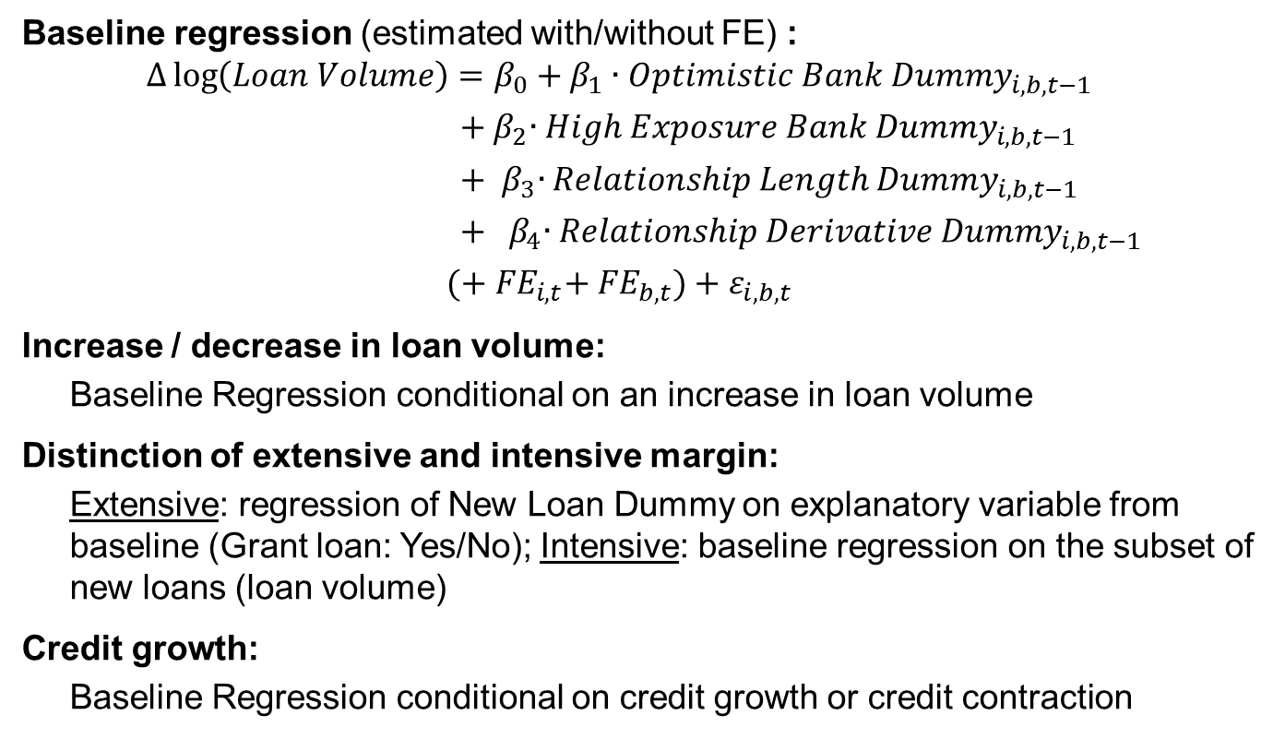
Empirical Design
Baseline regression (estimated with/without FE) :
$$∆\log\left(Loan Volume\right)=β_{0}+β_{1}∙{Optimistic Bank Dummy}_{i,b,t−1}$$
${ + β}_{2}∙{High Exposure Bank Dummy}_{i,b,t−1}$
${ + β}_{3}∙{Relationship Length Dummy}_{i,b,t−1}$
${ + β}_{4}∙{Relationship Derivative Dummy}_{i,b,t−1}$
$(+{{ FE}_{i,t}+ {FE}_{b,t})+ε}_{i,b,t}$
Increase / decrease in loan volume:
Baseline Regression conditional on an increase in loan volume
Distinction of extensive and intensive margin:
Extensive: regression of New Loan Dummy on explanatory variable from baseline (Grant loan: Yes/No); Intensive: baseline regression on the subset of new loans (loan volume)
Credit growth:
Baseline Regression conditional on credit growth or credit contraction

Slide 9
Results: Baseline Regressions
 | Increase in loan vol | Increase > 10% | Increase > 20%
Optimistic Bank | 0.024*** | 0.037*** | 0.048***
High Exposure Bank | -0.131*** | -0.226*** | -0.276***
Relationship Length | 0.019*** | 0.036*** | 0.048***
Relationship Derivative | 0.068*** | 0.110*** | 0.138***
Observations | 129,374 | 57,688 | 36,510
Adj. R-squared | 0.14 | 0.13 | 0.13
all regressions with borrower x quarter FEs and bank x quarter FEs

Slide 10
Results: Extensive versus Intensive Margin (Increase in log loan volume > 20% (bank-borrow level))
Dependent variable | Extensive margin: New loan dummy | Intensive margin: Change in loan vol
Optimistic Bank | 0.004** | 0.019
High Exposure Bank | -0.048*** | -0.362***
Relationship Length | -0.000 | 0.050**
Relationship Derivative | 0.028*** | 0.046*
Observations | 388,933 | 33,170
Adj. R-squared | 0.26 | 0.43
all regressions with borrower x quarter FEs and bank x quarter FEs

Slide 11
Results: Effect of Credit Market Conditions
Depended Variable: Increase in loan volume | Quarters with credit growth | Mean diff. | Quarters with credit Contraction
Optimistic Bank | 0.029*** | 0.008 | 0.020***
High Exposure Bank | -0.135*** | -0.008 | -0.127***
Relationship Length | 0.022** | 0.005 | 0.017***
Relationship Derivative | 0.071*** | 0.004 | 0.067***
Observations | 54,850 |  | 74,524
Adj. R-squared | 0.12 |  | 0.16
all regressions with borrower x quarter FEs and bank x quarter FEs

Slide 12
Conclusion
We find that …
A bank is more likely to provide more funds / a borrower is more likely to borrow from a bank, if …
the bank is optimistic with the borrower (low PD)
the bank has an under average exposure to the borrower (diversification)
the bank has a larger relationship scope with the borrower
The assigned PD only drives the decision phase to grant a loan / to lend from a bank (extensive margin), whereas the length of the bank-borrower relationship only determines the loan volume (intensive margin)
Credit market conditions do not affect the loan granting / lending process, but are economically more pronounced during quarters of credit growth
Our results are robust under a sample (median-) split by PD, loan volume and relationship length

Slide 13
Annex: Literature
Berger and Udell (1995), Relationship Lending and Lines of Credit in Small Firm Finance, Journal of Business
Broecker (1990), Credit-worthiness tests and interbank competition, Econometrica
Cebenoyan and Strahan (2001), Risk management, capital structure and lending at banks, Journal of Banking and Finance
Franke and Krahnen (2007), Default risk sharing between banks and markets: The contribution of collateralized debt obligations, The Risks of Financial Institutions
Goderis, B., Marsh, I., Vall Castello, J., and Wagner, W. (2007), Bank behaviour with access to credit risk transfer markets, Research Discussion Papers, Bank of Finland
Hirtle (2007), Credit derivatives and bank credit supply, Journal of Financial Intermediation
Kick, Pausch and Ruprecht (2013), The Winner’s Curse. Evidence on the Danger of Aggressive Credit Growth in Banking, Working Paper Deutsche Bundesbank
Petersen and Rajan (1994), Estimating standard errors in finance panel data sets: Comparing approaches, Review of Financial Studies
Riordan (1993), Competition and bank performance: a theoretical perspective, in Mayer, C., Vives, X. (Eds.), Capital Markets and Financial Intermediation
Shaffer (1998), The winner’s curse in banking , Journal of Financial Intermediation

Slide 14
Annex: Description of Variables
Variable | Unit | Description
Borrower characteristics
Borrower loan volume | Euro | Sum of the loan volume reported by all banks for a borrower in a particular quarter.
Bank relationships | Dummy(0/1) | Variable equal to one if a bank has a relationship with a borrower in a particular quarter.
Dispersion of PD | Percent (%) | Measure for the across-bank dispersion of PD estimates, defined by the standard deviation of all PDs for each borrower per quarter
Bank characteristics
Borrower relationships | Number | Number of borrowers reported by the bank in a particular quarter. All borrowers whose loans of the bank exceed € 1.5 million at least once during the quarter have to be reported.
Bank-Borrower characteristics
PD | Percent (%) | Probability of default over a 1-year horizon, measured from 0.00% to 100.00%.
Optimistic Bank | Dummy(0/1) | Variable is equal to one if the demeaned log of PD is less than 0.
High Exposure Bank | Dummy(0/1) | Variable is equal to one if the log of Exposure of default for a bank if larger than the mean across all banks.
Relationship | Dummy(0/1) | Variable equal to one if the length of the relationship for a given bank-borrower pair is larger than the average of this borrower with all lender.
Relationship Der. | Dummy(0/1) | Variable equal to one if the lender has a derivative for the credit.
Length of relationship | Number | Number of Quarters that a credit relationship lasts for a given bank-borrower pair, measured from the date of the first relationship to the actual date.

Slide 15
Annex: Summary Statistics (1/2)
Variable | Level | Unit | N | Mean | Std.Dev. | p25 | Median | p75
Borrower characteristics
Borrower loan volume | Borrower-Quarter | EUR mn | 175,393 | 38.46 | 74.33 | 5.12 | 12.75 | 37.58
Bank relationships | Borrower-Quarter | Number | 175,393 | 2.73 | 1.43 | 2 | 2 | 3
Dispersion PD | Borrower-Quarter | Percent | 175,393 | 1.33% | 2.57% | 0.12% | 0.38% | 1.13%
Bank characteristics
Borrower relationships | Bank-Quarter | Number | 830 | 577.01 | 669.82 | 163 | 311 | 849
Bank-Borrower characteristics
PD | Bank-Borrower-Quarter | Percent | 478,916 | 1.66% | 3.28% | 0.23% | 0.59% | 1.42%
Optimistic Bank Dummy | Bank-Borrower-Quarter | Dummy | 478,916 | 0.53 | 0.50 | 0 | 1 | 1
High Exposure Bank Dummy | Bank-Borrower-Quarter | Dummy | 478,916 | 0.49 | 0.50 | 0 | 0 | 1
Relationship Dummy | Bank-Borrower-Quarter | Dummy | 478,916 | 0.59 | 0.49 | 0 | 1 | 1
Derivative Dummy | Bank-Borrower-Quarter | Dummy | 478,916 | 0.24 | 0.43 | 0 | 0 | 0
Length of relationship | Bank-Borrower-Quarter | Number | 478,916 | 27.53 | 22.90 | 9 | 21 | 43

Slide 16
Annex: Summary Statistics (2/2)

Slide 17
Annex: Correlations for Determinants of bank‘s lending decisions

Slide 18
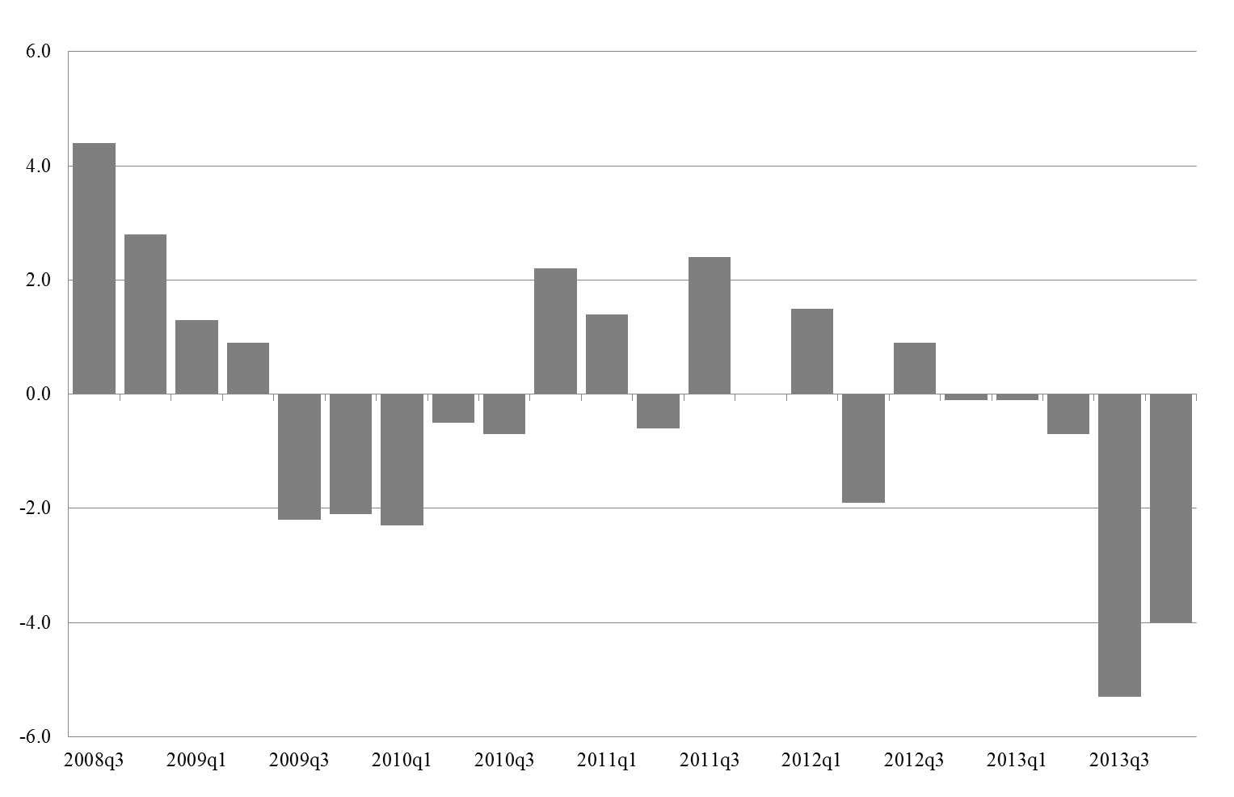
Annex: Change in Credit Volume (YoY in %)

Slide 19
Annex: Determinants of Bank‘s Lending Decisions

Slide 20
Annex: Increase versus Decrease in Loan Volume

Slide 21
Annex: Extensive versus Intensive Margin

Slide 22
Annex: The Effect of Credit Market Conditions

Slide 23
Annex: Robustness Test - Median Sample Split

